Slide 1
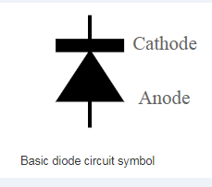
DIODE & TYPES OF DIODE Like all electronic components, diodes have a circuit symbol that is used within electronic circuit diagrams. The basic circuit symbol for the diode consists of a triangle with its point touching a short line perpendicular to the wire on the circuit diagram. Sometimes the triangle and even the line are just shown in outline, whilst at other times they are shown as filled black shapes. BASIC DIODE CIRCUIT SYMBOL Sometimes the diode circuit symbol is shown only as an outline and without the filled in shapes. The outline shape is equally acceptable.

Slide 2
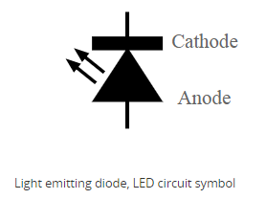
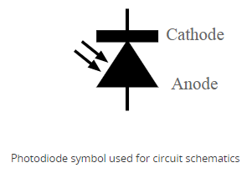
TYPES OF DIODE Light emitting diodes: The light emitting diode or LED is one of the most popular types of diode. When forward biased with current flowing through the junction, light is produced. The original colour for these diodes was red, but these days most colours are available. This is achieved by using different mixes of semiconductors either side of the PN junction. Photodiode: When light strikes a PN junction it can create electrons and holes, causing a current to flow. As a result it is possible to use semiconductors to detect light. These types of diodes can also be used to generate electricity. For some applications, PIN diodes work very well as photodetectors.

Slide 3
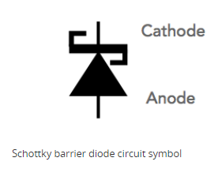
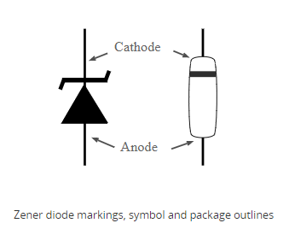
Schottky diodes: This type of diode has a lower forward voltage drop than ordinary silicon PN junction diodes. At low currents the drop may be somewhere between 0.15 and 0.4 volts as opposed to 0.6 volts for a silicon diode. To achieve this performance they are constructed in a different way to normal diodes having a metal to semiconductor contact. They are widely used as clamping diodes, and in RF designs, often as signal detectors. They are also used as power diodes for rectification of AC power in power supplies and the like. The lower losses caused by the smaller drop are significant in improving the efficiency. Zener diode / voltage reference diode: The Zener diode is a very useful type of diode. It is run under reverse bias and when a certain voltage is reached it breaks down. If the current is limited through a resistor, it enables a stable voltage to be produced. This type of diode is therefore widely used to provide a reference voltage in regulated power supplies.

Slide 4
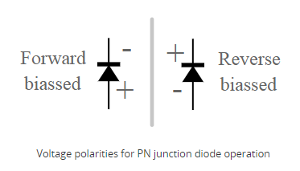
PN Junction: The standard PN junction may be thought of as the normal or standard type of diode in use today. This electronic component is incorporated into many electronic circuits designs and it is also used in many RF circuit designs as well. These diodes can come as small signal types for use in radio frequency, or other low current applications, or other types may be high current and high voltage ones that can be used for power applications.

